Slide 1
Vision Program Semantic Understanding
July 24, 2019
中澤 満 (Mitsuru Nakazawa) Ph.D.
Rakuten Institute of Technology Tokyo Rakuten, Inc.

Slide 2
Our Vision
Semantic Information Extraction/Understanding towards Visual Task Automation & Support

Slide 3





Targets & Project types
Targets
Web Image
Document Image
Video
Project types
Business Project
Academic Project

Slide 4
Future vision: Towards human level visual understanding
Past
Present
Future
Adaptive recognition
Feature extraction
Fine-grained classification
Semantic segmentation
Adaptive Category Prediction
Object detection
Context understanding
PDF Segmentation
Graph digitalization
Object detection
Summarization
Context understanding
Content synthesis
Video Summarization

Slide 5


1. Adaptive Category Prediction
Web Image Understanding
Academic Project

Slide 6
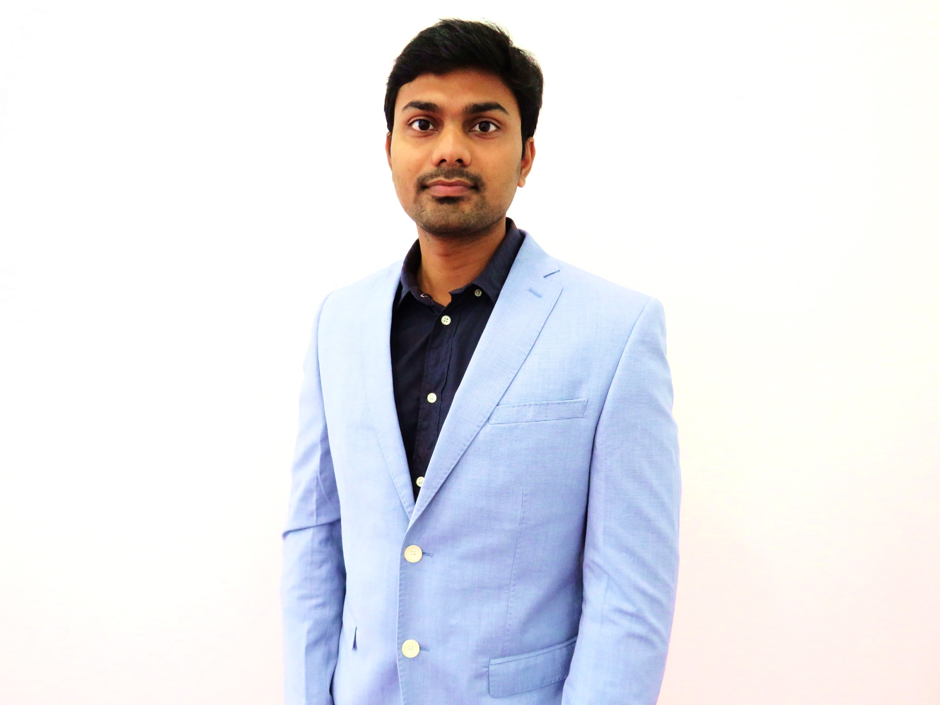
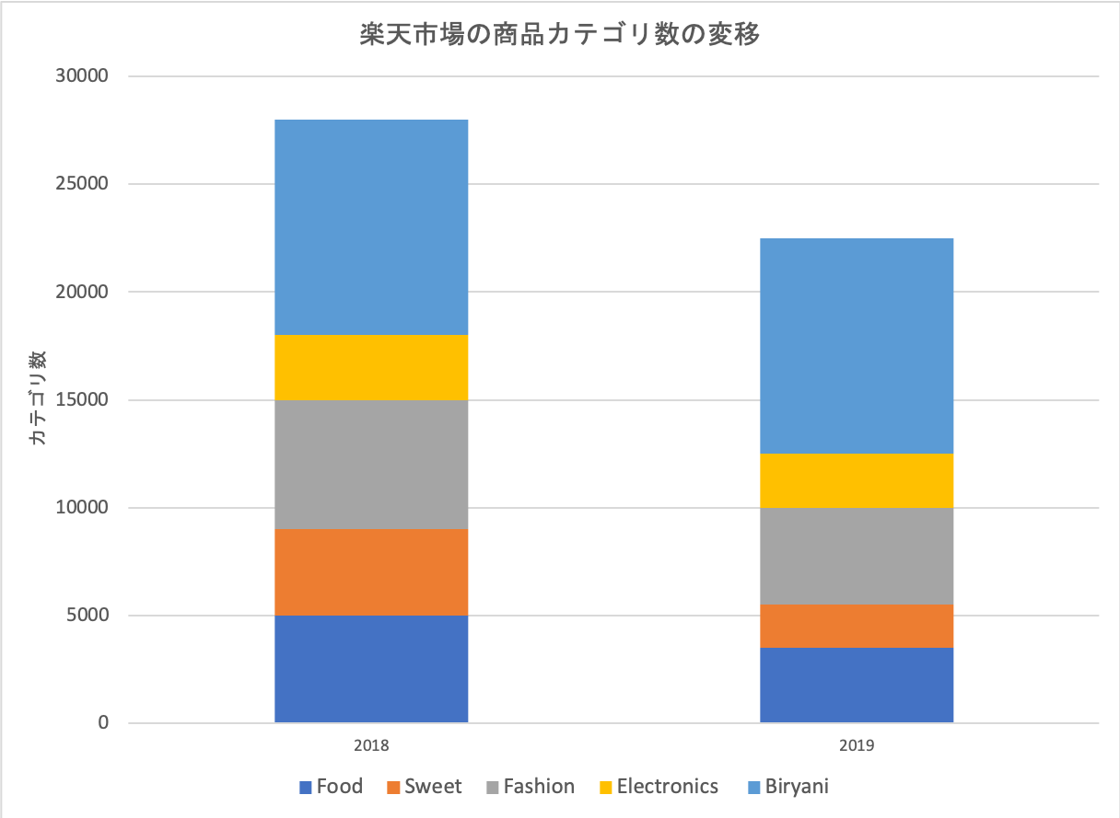
Adaptive Category Prediction
To be updated!
Kobagapu Rao
Mitsuru Nakazawa
Objective
With ever increasing items in Ichiba, it would be impossible to maintain a item catalogue with current SPS and Semi-manual labeling approach.
Till now both NLP and Computer Vision approaches have shown promising results in this field. But they don’t take the advantage of combination of multi modal data.
We are trying to solve the Ichiba item classification problem with the use of multi-modal approach. ( 260 MM items and 10,000 classes tall end classification problem )
We will also research on techniques to deal with the dynamic genre definition. ( 40% of item genre change every two months )
Expected Benefits
KPIs
Paper publication
Solve business problem
Create a generalized pre-trained deep learning model for transfer learning
Accuracy
Paper publication & patents
Business cost reduction

Slide 7
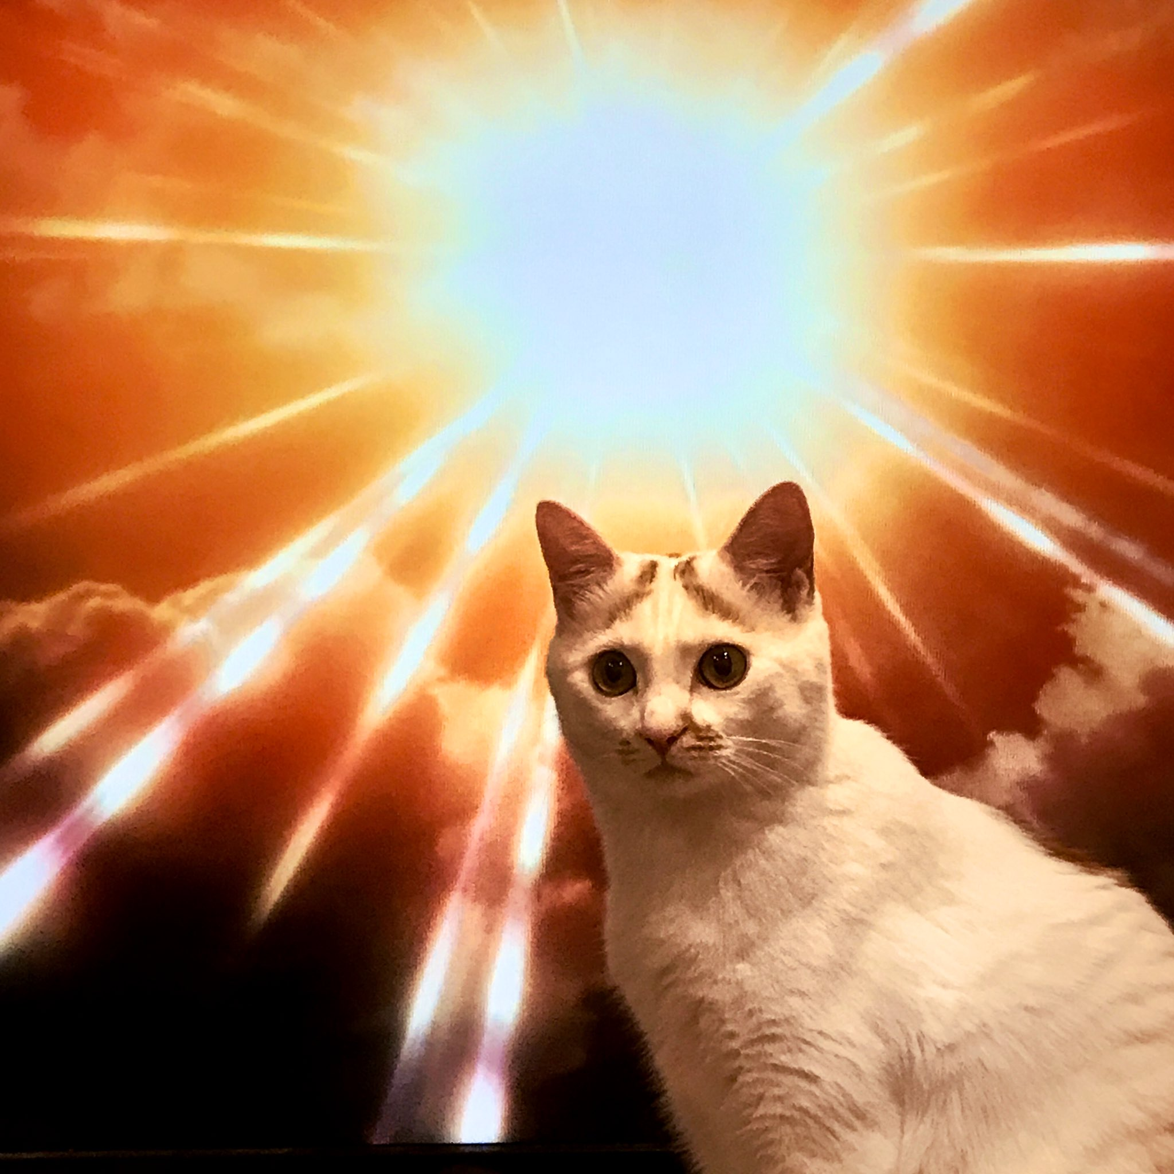
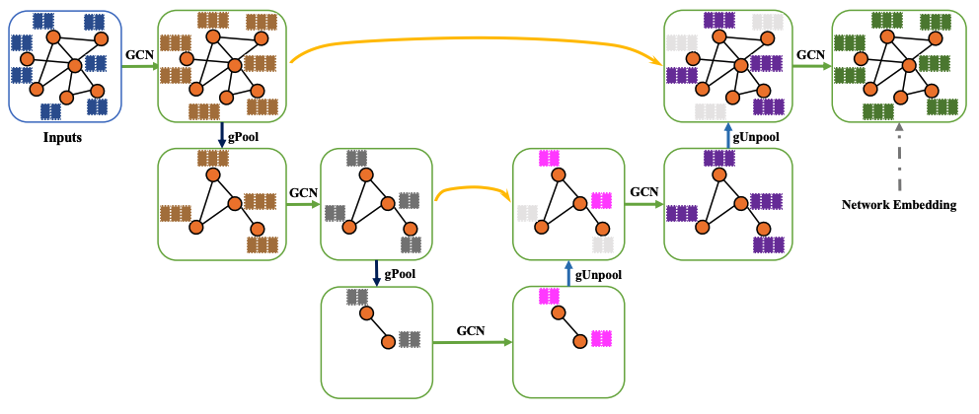
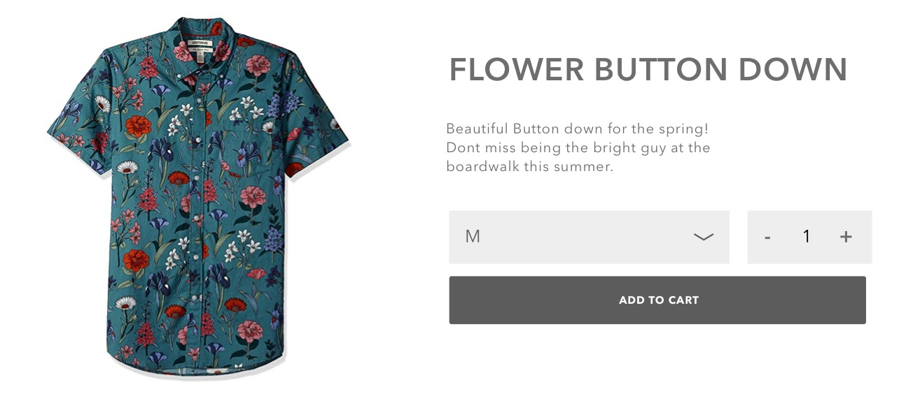
Timeline
Basu
Nakazawa
Tsutsumi
To be updated!
From Aug. to Oct.
Literature survey to deal with fine grained classification and dynamic genre mapping
From Nov. to Jan.
Train pure vision model and compare it correlation with NLP model, if the correlation is low, we can expect a good boost in accuracy by ensemble model of both modality.
Paper writing for CVPR

Slide 8


2. PDF Segmentation
w/ Aquafadas
Document Image Understanding
Business Project

Slide 9

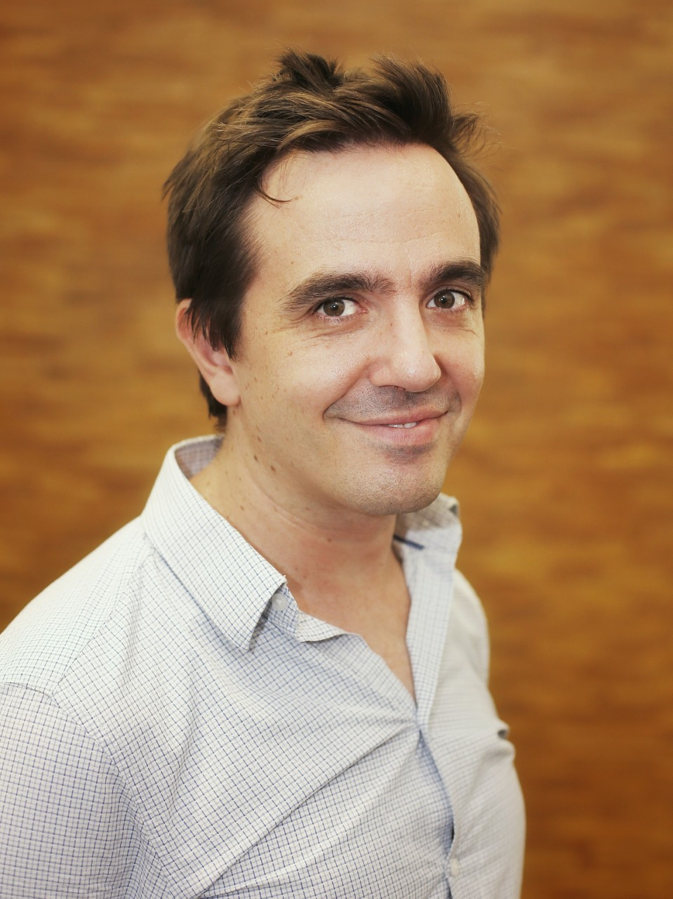
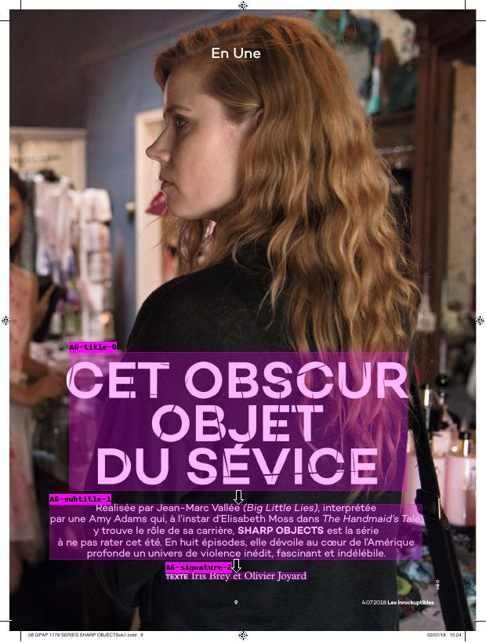
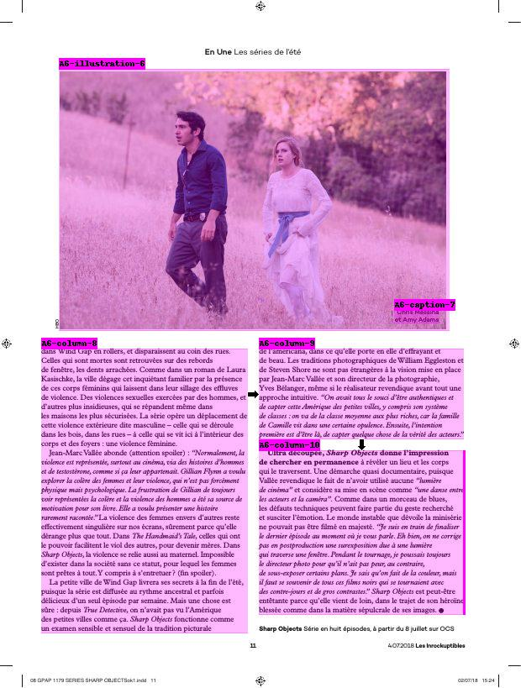
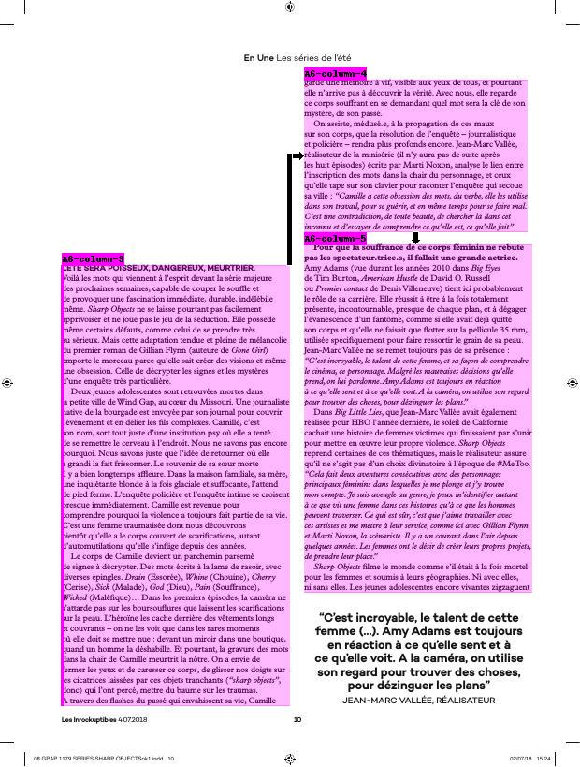
PDF Segmentation
Aloïs de La Comble
Ken Prepin
Objective
Rakuten Aquafadas would like to propose a new feature for publishers that converts PDF magazines to responsive web content.
We currently have a prototype that works on a few magazine types.
We have to make it more robust and make it easier to bring in new magazines.
Expected Benefits
KPIs
Create a new differentiating feature for Rakuten Aquafadas' offer
Classification accuracy
Time needed to bring in a new magazine
Final client usage

Slide 10
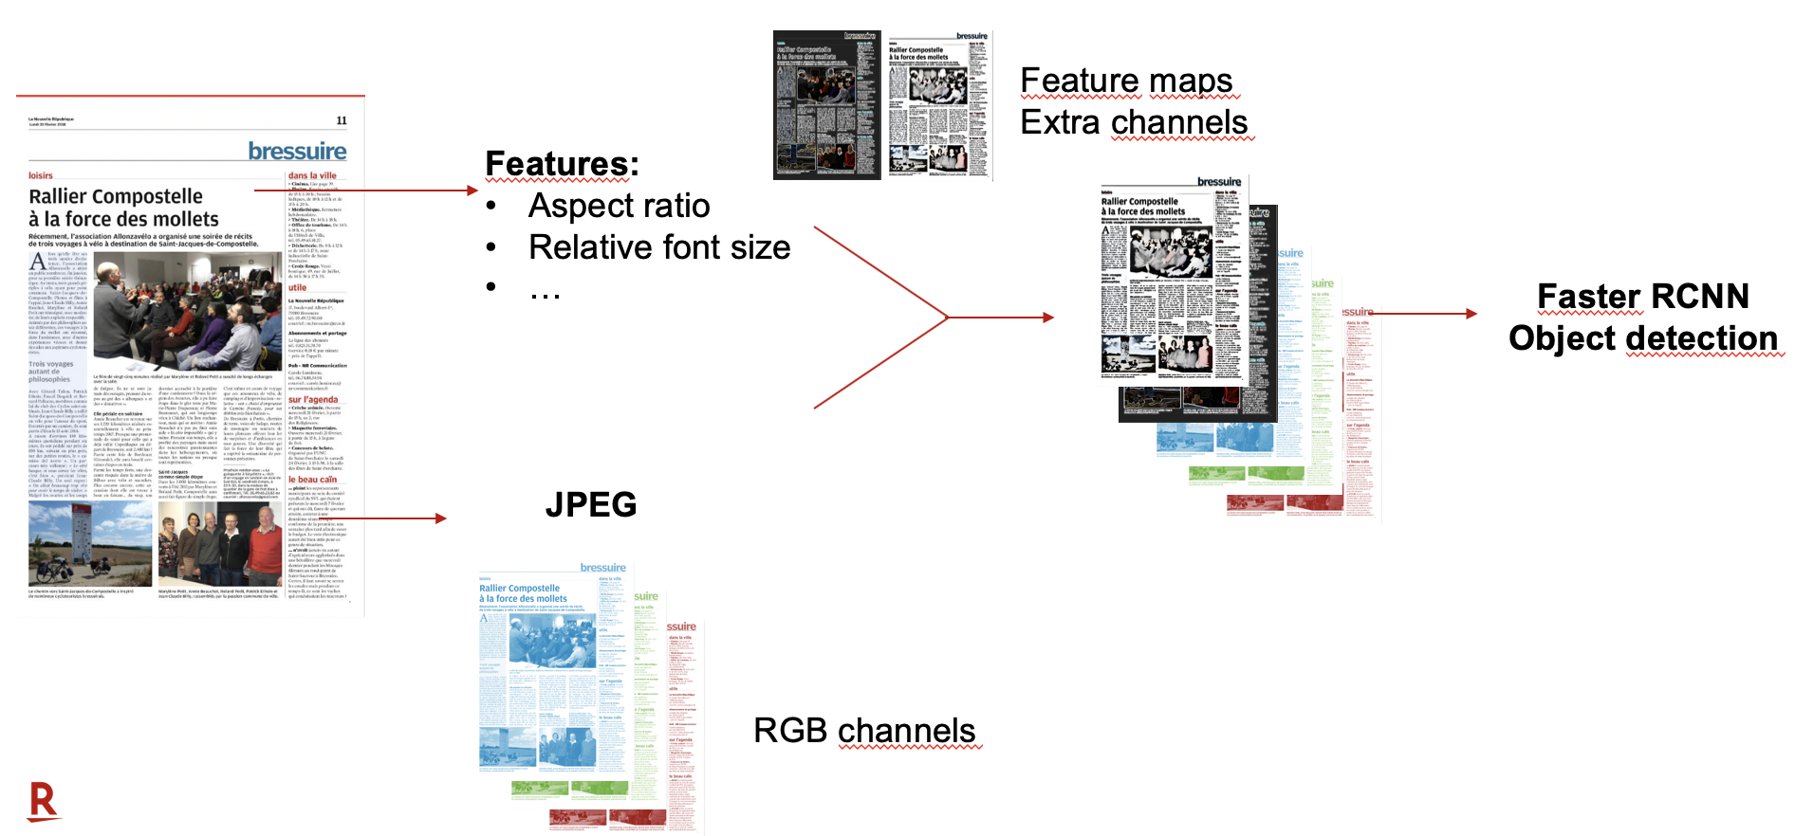

Timeline
Aloïs de La Comble
Ken Prepin
From Aug. to Oct.
﻿To adapt pipeline for PwC magazines
More accurate title detection: we take advantage of multimodal inputs (PDF can be parsed as XML or converted to JPEG)
Improve output to have the best display possible
Evaluation on PwC magazines
From Nov. to Jan.
For system improvement
Use semantic approach to merge close articles and / or improve classification
Adapt training pipeline to generalize better to new magazines type (e.g. by crawling web pages to generate more data)
Adapt pipeline for other clients if necessary
Patent the idea

Slide 11
3. Graph Digitalization
for Financial Data
w/ SECB
Document Image Understanding
Business Project

Slide 12
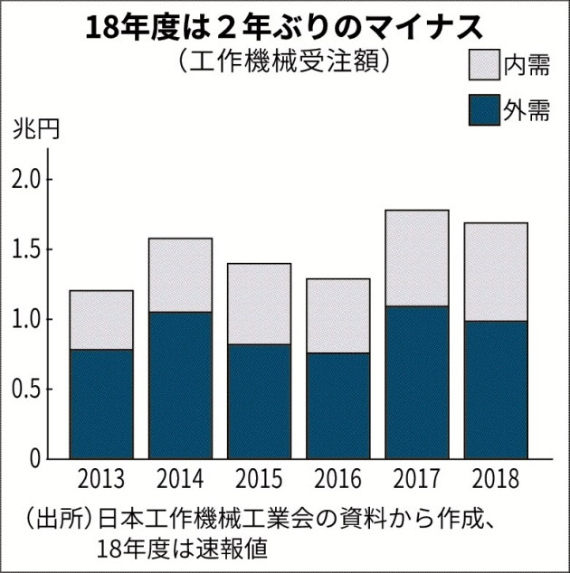
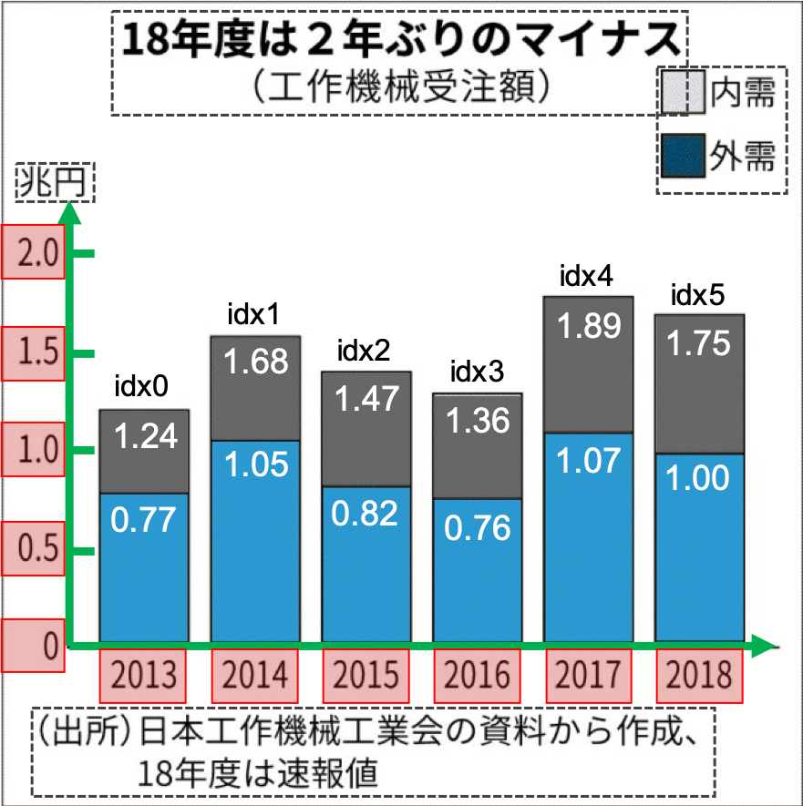

Graph Digitalization
Mitsuru Nakazawa
Internship student (from Aug.)
Coming soon
Objective
Projectの難しさ：
いろいろなグラフを適切に理解すること Appendixで例を用意
Rakuten Investment Management (RIM) is analyzing various graphs of financial data open to public in their investment process
In order to enhance RIM’s effective analysis, RIT will develop a digitalization tool for scanned images of these graphs
Scanned image
Digitalization
CSV
Difficulty: Understand various kinds of graphs like human beings
Expected Benefits
KPIs
Reduce 250 hours / year and 10 times more after implemented
Strengthen research quality with quantitative accuracy
Embed into evolving RIM’s data & AI driven investment process
Processing time
Accuracy
Number of graph patterns

Slide 13
Timeline
Mitsuru Nakazawa
Internship student (from Aug.)
Coming soon
From Aug. to Oct.
Goal setting with SECB
Try non-deep learning approach (as baseline)
Manual annotation for evaluation
From Nov. to Jan.
Evaluation & Get feedback from SECB
Try deep learning approach with synthesized training data
Paper writing in case we get good results

Slide 14

4. Video Summarization
w/ Chubu Univ.
Video Understanding
Academic Project

Slide 15

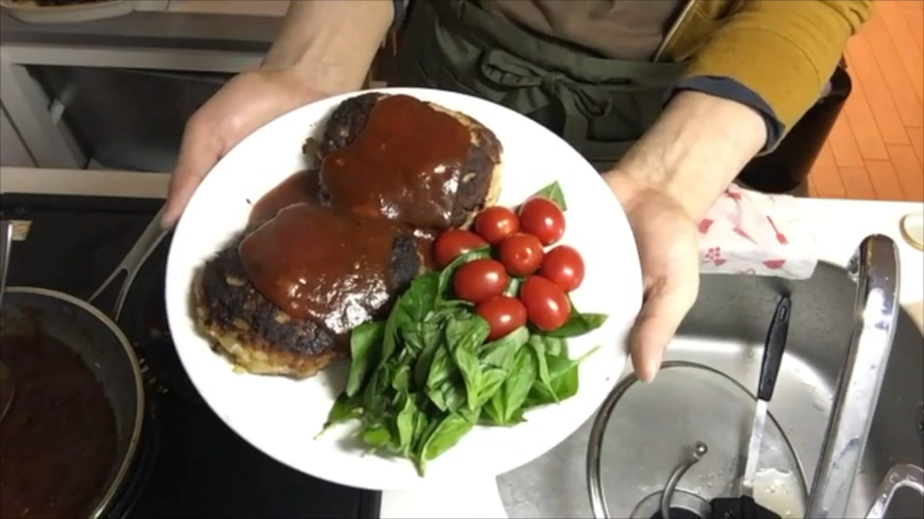
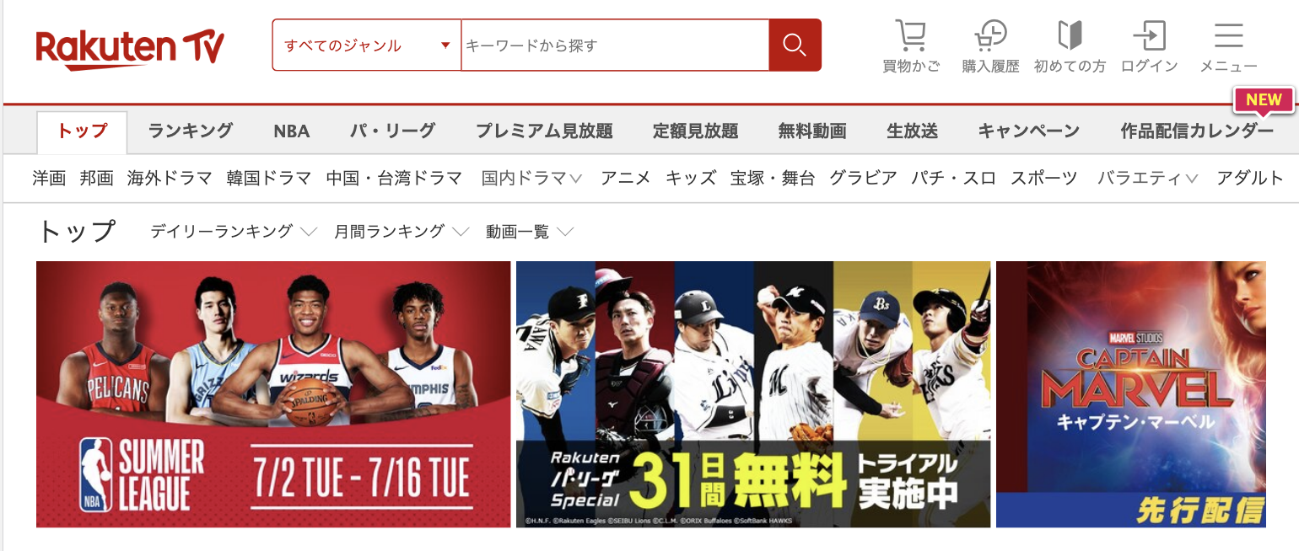

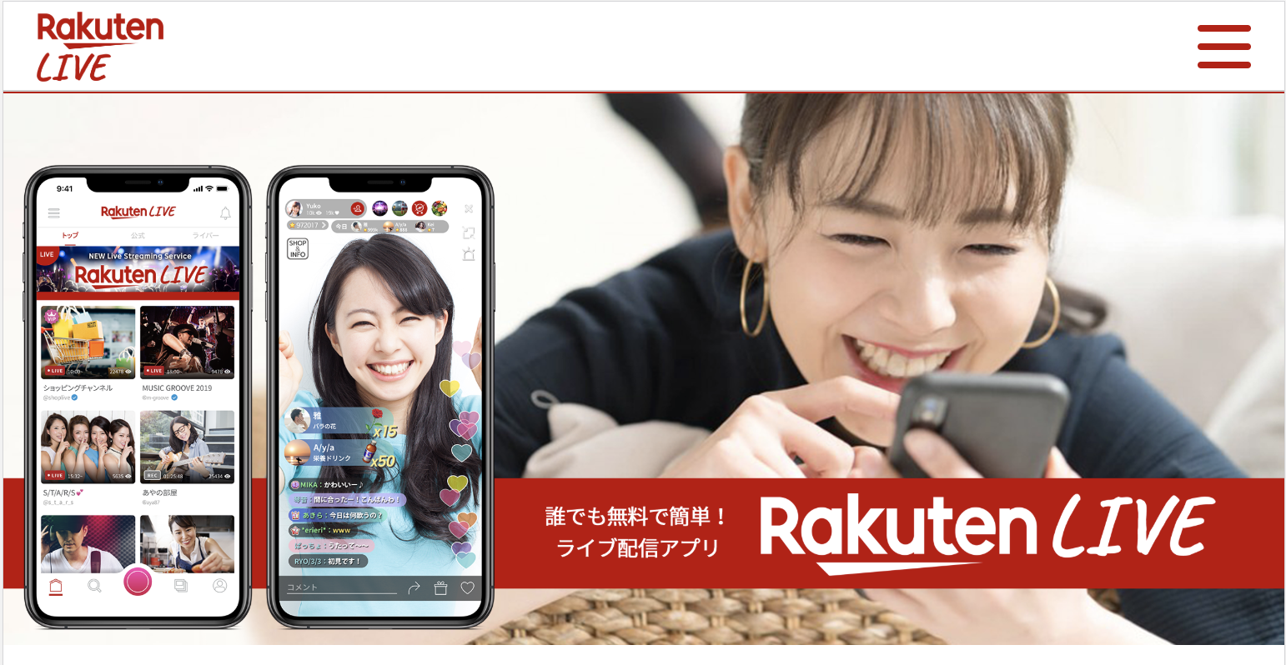
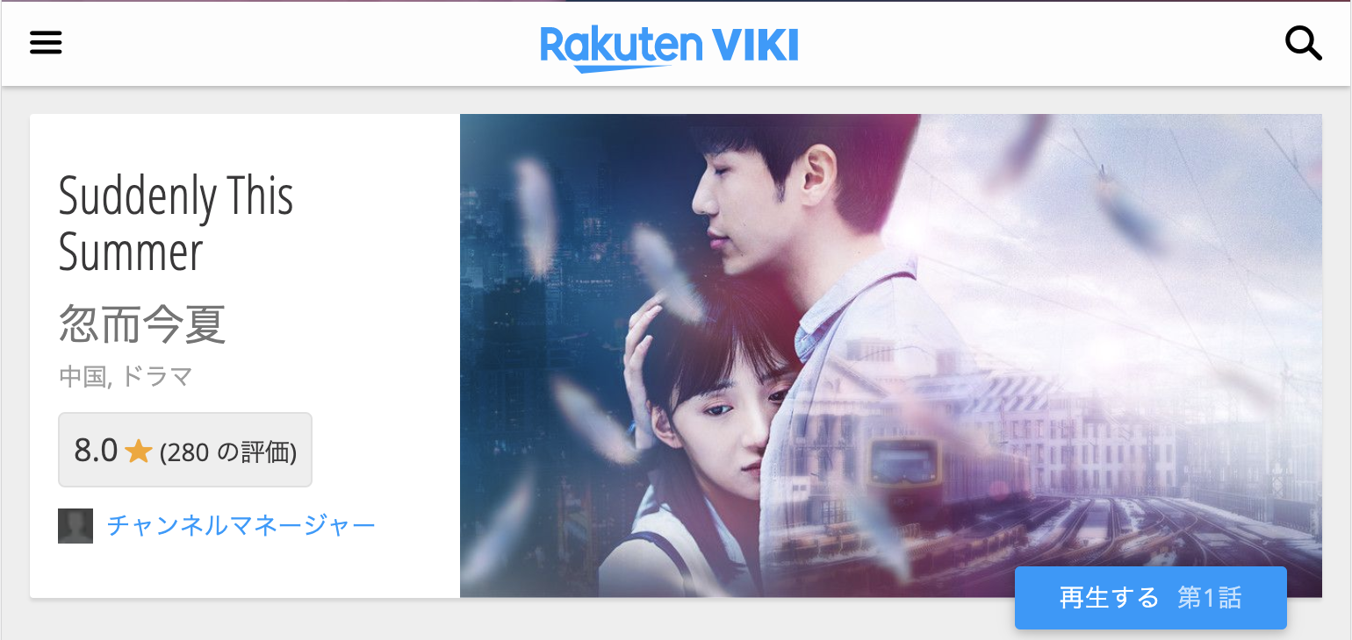

Video Summarization
Mitsuru Nakazawa
Yeongnam Chae
Chubu University
Objective
As-is: For cooking video
To-be: For various kinds of video
40min
1min
R. Sobue, et al., "Cooking Video Summarization Guided By Matching with Step-By-Step Recipe Photos," Proceedings of the 16th International Conference on Machine Vision Applications (MVA2019), 2019, Oral
Expected Benefits
KPIs
Ready for future potential business using Video summarization
Superframe technology can be utilized for any video analysis to shorten processing time
# of Papers / Patents
# of Yokoten

Slide 16
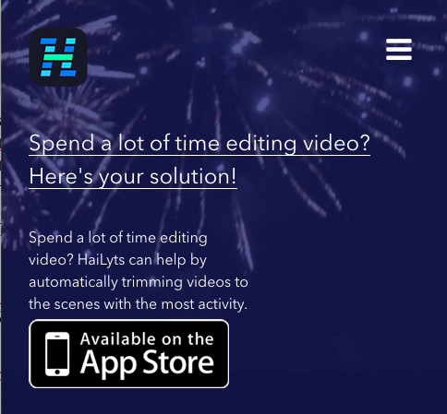
Timeline
Mitsuru Nakazawa
Yeongnam Chae
Chubu University
From Aug. to Oct.
Develop a non-DL approach
Paper survey
Eli Shechtman, et al., “Space-Time Behavior-Based Correlation — OR — How to Tell If Two Underlying Motion Fields Are Similar without Computing Them?,” TPAMI, pp.2045-2056, 2007
From Nov. to Jan.
Consider & Propose a DL-based approach
Paper writing in case we get good results

Slide 18
Appendix

Slide 19
Research topics
Adaptive Category Prediction
PDF Segmentation
Graph Digitalization for Financial Data
Video Summarization

Slide 20
Hoge Hoge
Document Image Understanding
Business Project
Video Understanding
Web Image Understanding
Academic Project

Slide 21
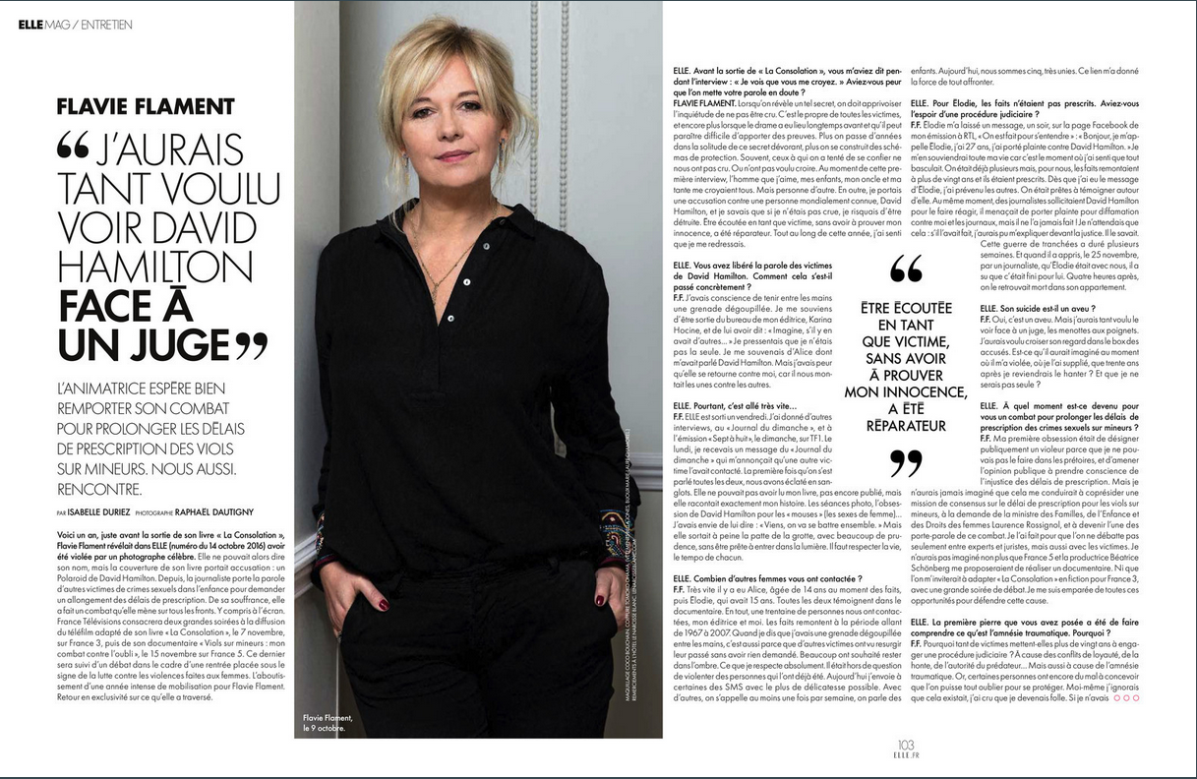

Notes:
Still, this is very unconvenient if the publisher now wants to propose the content for reading on a mobile for instance.
The reader cannot see the whole article at once and has to zoom in a lot.

Slide 22
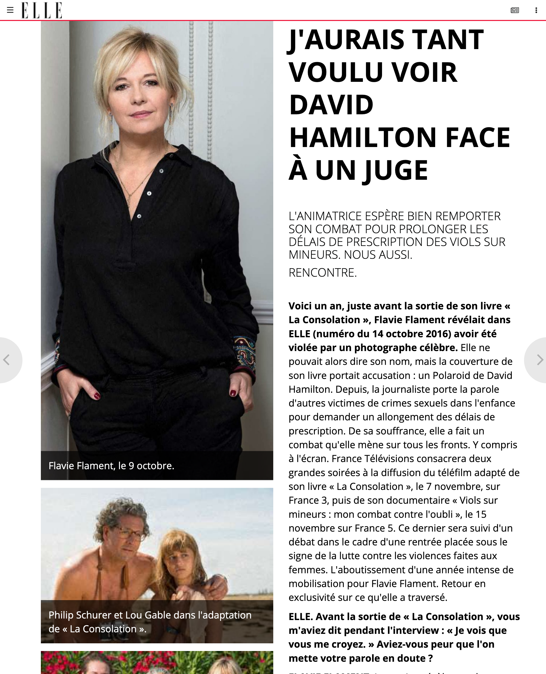
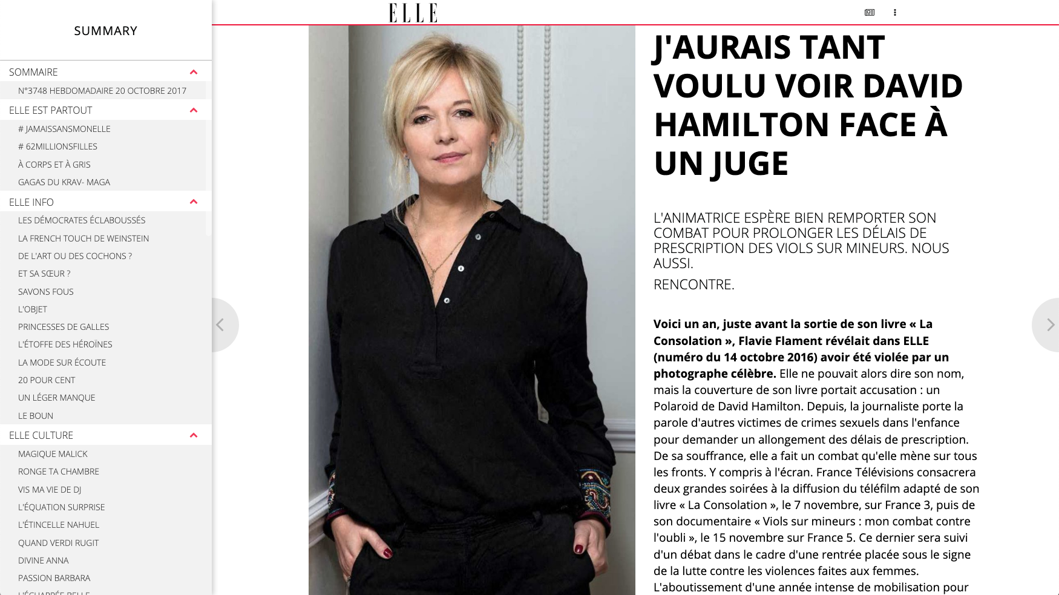
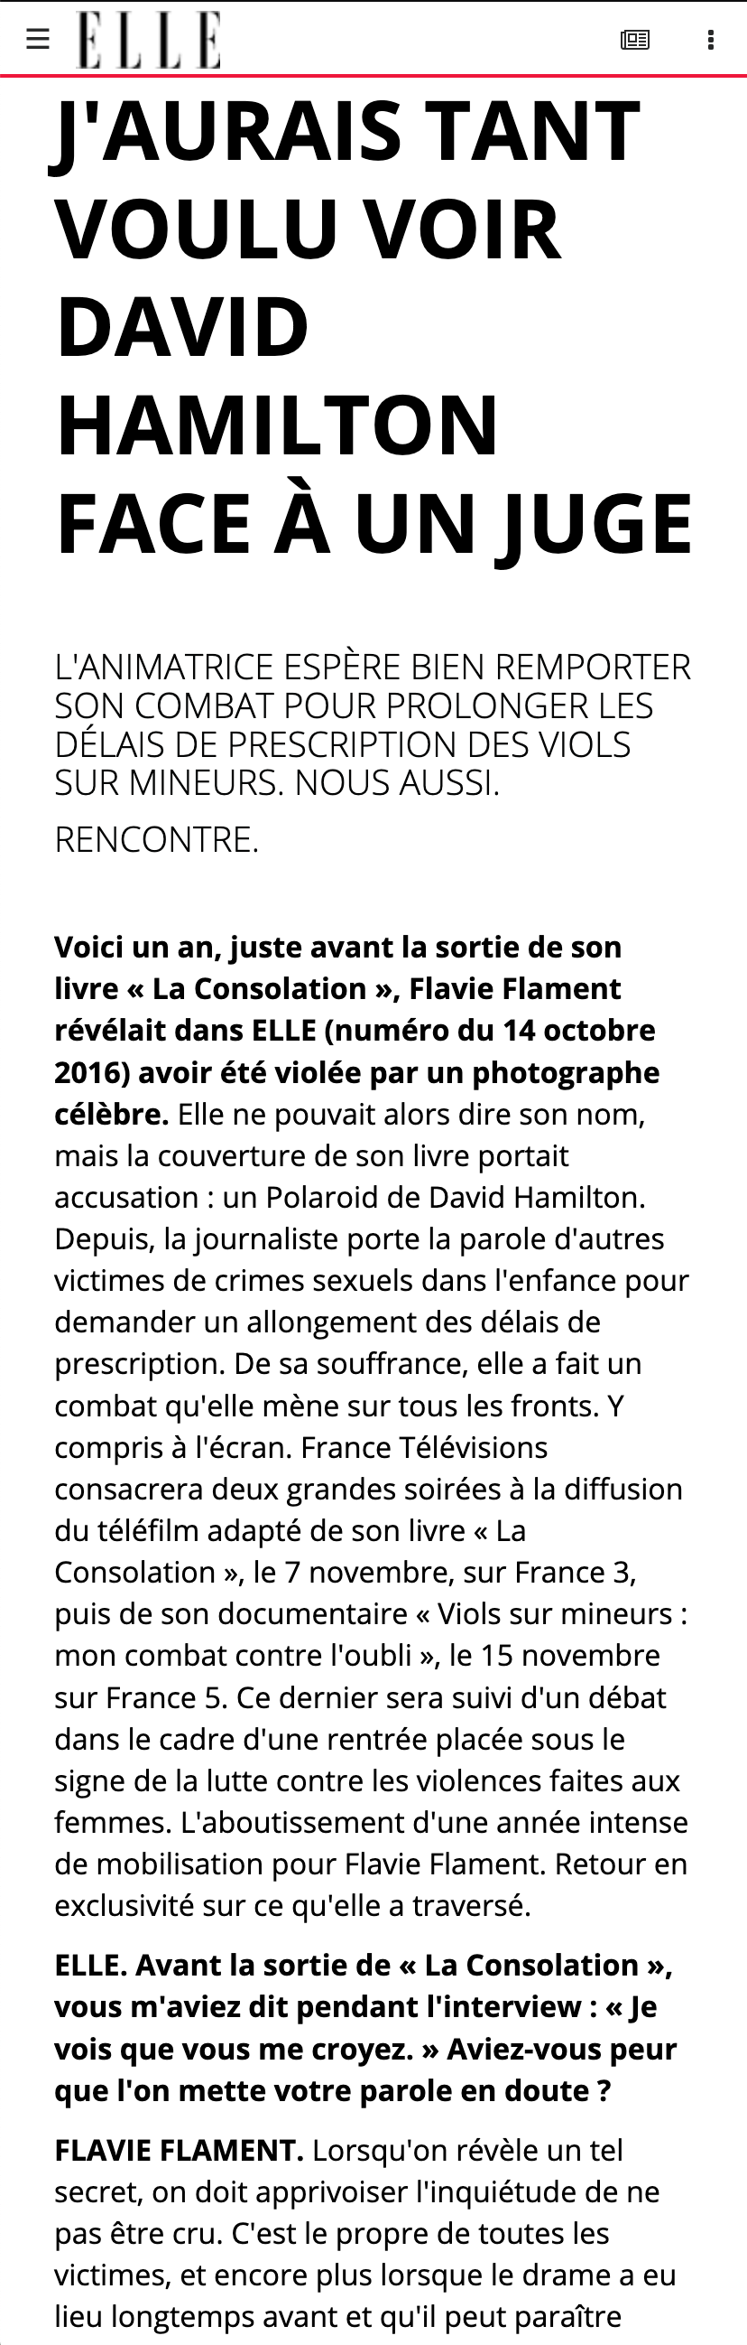
Notes:
Whereas if he has a web responsive content, the text will adapt and be easy to read. Currently, only a few publishers can afford to have their content responsive as they have to rebuild entirely the magazine for web.

Slide 23
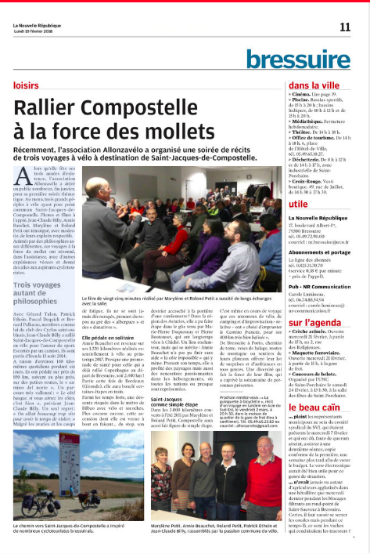
Proposed solution: main steps
Detect articles parts
PreTitle
Column
Signature
Title
Illustration
SubTitle
Caption
Notes:
First of all, we find different blocs of text. We can call them article parts or paragraphs.
These blocs have to be identified in different categories: title, column, illustration and so on.

Slide 24
Proposed solution: main steps
Detect articles parts
Cluster parts to build the articles
Article #1
PreTitle
Column
Signature
Article #2
Title
Illustration
SubTitle
Caption
Notes:
Then, these parts will be clustered into articles.

Slide 25
Proposed solution: main steps
Detect articles parts
Cluster parts to build the articles
Sort parts in reading order
Article #1
Article #1
PreTitle
Column
Signature
Article #2
Title
Illustration
SubTitle
Caption
Notes:
Inside each article, we also need to determine what is the natural reading order.

Slide 26
Proposed solution: main steps
Track articles on multiple pages
Notes:
And finally, as some articles can be spread across multiple pages, we need to stitch back the article in one piece

Slide 27
Detecting articles
Text lines approach
Vision approach
Info for each line of text:
Font size
Color
…
JPEG
Features:
Aspect ratio
Relative font size
…
Faster RCNN Object detection
Random Forest Classifier
Notes:
There are two approaches for this.
Each of them is based on a different interpretation of the format of the PDF.
The first approach is to parse the PDF and extract its text with the corresponding features. We can then feed this to a standard machine learning algorithm.
Another approach is to treat each page as a single JPEG image and feed them to a faster RCNN.

Slide 28
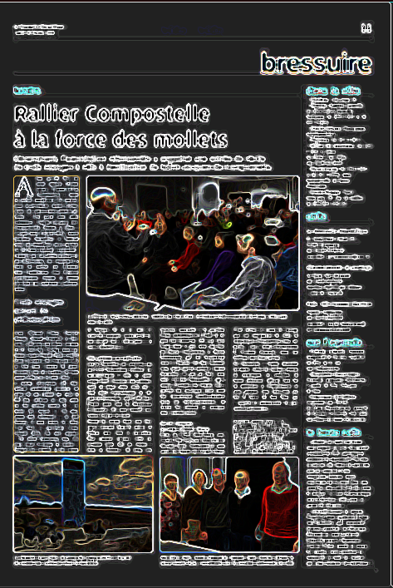
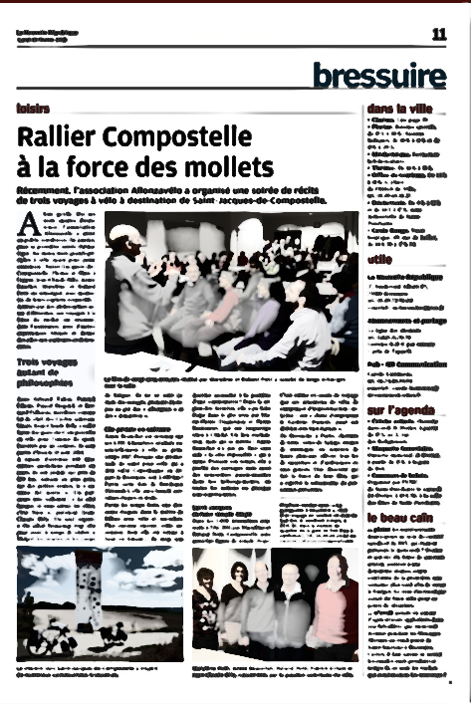
How to take benefit from both models ?
Feature maps
Extra channels
Features:
Aspect ratio
Relative font size
…
Faster RCNN
Object detection
JPEG
RGB channels
Notes:
Rather than merging the results at the end of the models, we thought it would be a good idea to add the features used by the text line model to the vision model as extra channels.
We are currently working on this idea.
We are also thinking of skipping or constraining the region proposal phase with the regions found with paragraph clustering.

Slide 29
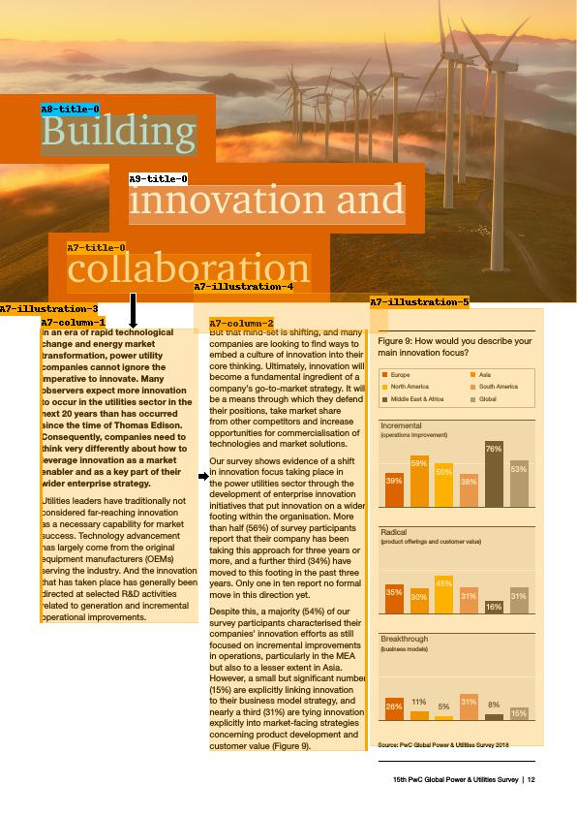
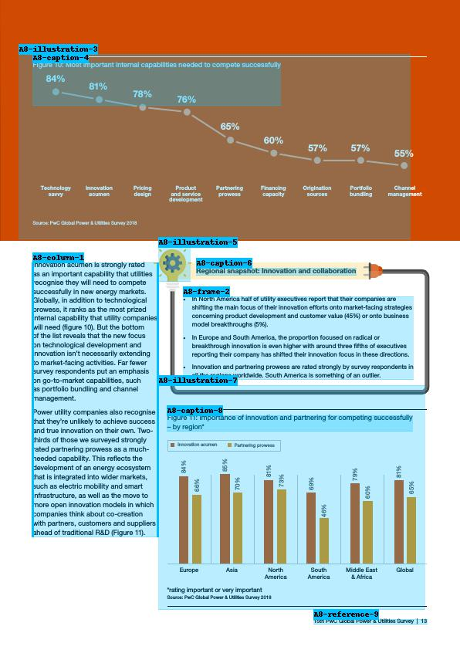
Notes:
When we started to work on PwC's documents, we noticed that the model sometimes had troubles finding titles.
Here you can see that finding two titles instead of one broke the article in two pieces.
Also, articles often don’t have capital letters keywords, so we cannot asses their semantical closeness to make up with title errors.

Slide 30

PDF Segmentation: impact for Aquafadas
Aquafadas created a new feature for their offer: « Smart Re-flow »
Aquafadas clients show real interest for this new feature
PwC asked for a pilot ---> current work
Proposed in RFP to a big client (waiting for return)
Notes:
As a conclusion, I have to say it is a very interesting project and Aquafadas is really implied in it as it can be « a game changer » for them using their words. They are already proposing their client this new feature they named « smart reflow ».

